Slide 1


Habit Tracker
Aaron Alex Sequeira

Slide 2

Introduction
Brief overview of the habit tracker program
The habit tracker application is an application used to track users habits and analyze them to provide an accurate statistic on the habit using different functions from the class
Importance of habit tracking for personal development
Habit tracking can be used for personal gain such as breaking a habit where you bite your nails or it can be used to develop useful habits such as practicing your coding skills by doing more problem solving and the habit tracker reminds you of these habits that you must complete
Objectives of the presentation
To achieve greater understanding of the project

Slide 3
Program Overview
Description of the main functionalities provided by the program
The main function in the program denoted by the __main__ is the heart of the project as it initializes the object habit which allows the main function to access the function of the habit class, the project has a non parameterized constructor which asks the user to login or register to create or login. Features such as habit creation, removal, checking off, and analysis. The main function is the main CLI which uses questionary as its cli as it is clean
Importance of each feature in habit tracking
Each function has its own importance as some functions are used for other functions to operate such as checkoff() function needs analyze function to be accessed and how timer_function() is used when checkoff() is executed. The viewAllHabits() function is used to view all the current habits in the database and the variations of the function such as longestStreak(), latestStreak(), most_Struggling_habit(), least_Struggling_habit(), Daily_habits()
Weekly_habits() and the _init_() function used to create an account

Slide 4

Implementation Details
Explanation of the main components of the program
The main components of this programs are _init_,create habit, remove habit ,modify a habit and analyze habit each function has its own uses as create habit is used for the user to create a new habit by inserting the required information/data. The remove habit is used for the user to remove an existing habit in the database by inserting the name to the program. Finally the analyze function is used to manage and view the existing habits
How Python's threading module is used for implementing timers
The implementation of threads in the project is used to uncheck and break habits that have been checked after the user inserted the name of the habit in the checkoff() function that sets off a timer.
Use of questionary library for user input
The use of questionary is to create a clean CLI instead of inserting numbers to navigate throughout the program and to avoid potential errors in the program

Slide 5

Class Structure
The project revolves around one class and it is called the habit class, in this class there are various functions needed to track the habit and analyze it and to view them. The class provides various functions for sorted view and to modify the habits. These habits can be removed by the user by inserting their name and can create habits by inserting the data required for the program to analyze the habit. The class uses a non parameterized constructor to login to an account to add or remove or modify a habit.

Slide 6
Database Schema
Overview of the MySQL database schema used for storing habit data
The main database used called habittrackerdb contains the table habits where the data is stored
The database will have multiple tables for different users after they create an account
Table and its attributes:
1,name,habittrackerdb,habits,VARCHAR.
2,time_Since_Creation,habittrackerdb,habits,VARCHAR.
3,Total_hours,habittrackerdb,habits,INT.
4,start_Date,habittrackerdb,habits,DATE.
5,minutes_Saved,habittrackerdb,habits,INT.
6,checked,habittrackerdb,habits,TINYINT.
7,streak,habittrackerdb,habits,INT.
9,Check_date,habittrackerdb,habits,DATE.
8,Habit_Type,habittrackerdb,habits,VARCHAR.
Importance of data organization for efficient habit tracking
The data stored in the table is used for the calculation of the time saved and time since creation

Slide 7
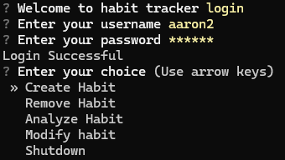
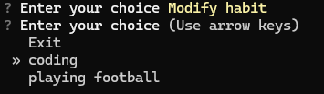
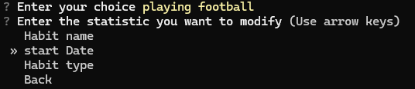


Demonstration
Screenshots or code snippets showcasing modify habit

Slide 8
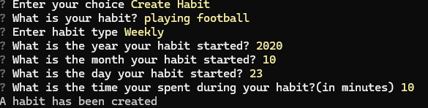
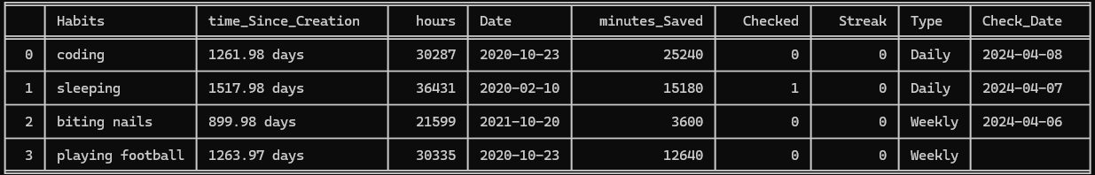
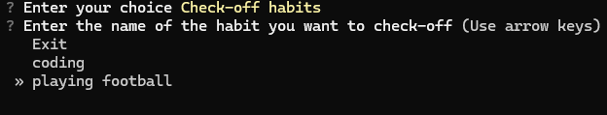
Demonstration
Screenshots or code snippets showcasing the program in action
Example scenarios of creating, checking off, and analyzing habits

Slide 9
Performance and Scalability
performance of the program with large datasets
The program has passed all the test and the components have been tested and work without errors
Potential optimizations for improving performance
The program has been optimized for creating a new account and handling more users to the database

Slide 10
Conclusion
Summary of key points covered in the presentation
Habit class: -The core functionality is encapsulated within the Habit class.
Database Interaction:-The program interacts with a MySQL database to store habit data.
Functionality: -Habit creation involves specifying details such as name, start date, time spent, and habit type (daily or weekly).
Reflection on the design and implementation process
Design Patterns: The code follows a procedural programming style with a class (Habit)
Database Interaction: Interaction with the MySQL database is implemented using the “mysql.connector” library.
User Interaction: The program utilizes the questionary library for user input.

Slide 11

Future enhancements and potential areas for further development
Adding authentication to the project to have more than one user
Better habit management system to better the user experience
Using a real user interface(UI) framework to make the app more user friendly
Adding more statistics on the habit to give more information to the user

Slide 12
Therefore, this is the brief overview of the projects and how it works, the key components and the main functions

